Slide 1
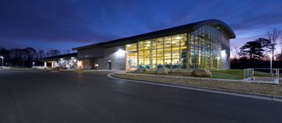
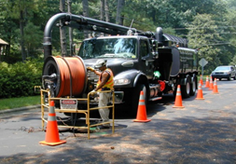
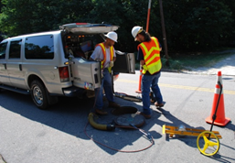
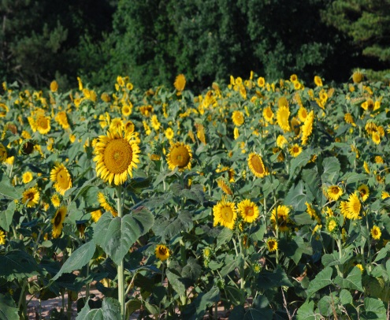
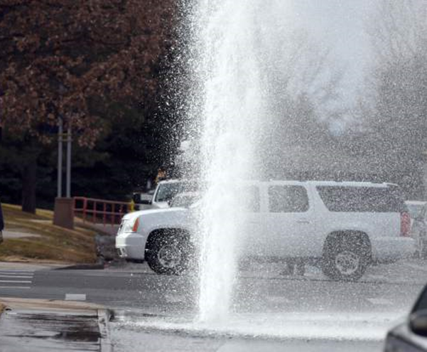
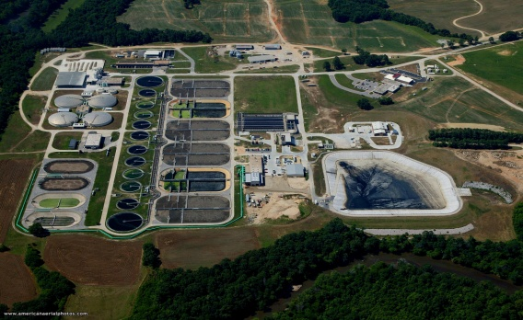
Raleigh Public Utilities Department
Water Allocation Committee
Improving Systemwide
Water Efficiency
July 10, 2019
1

Slide 2
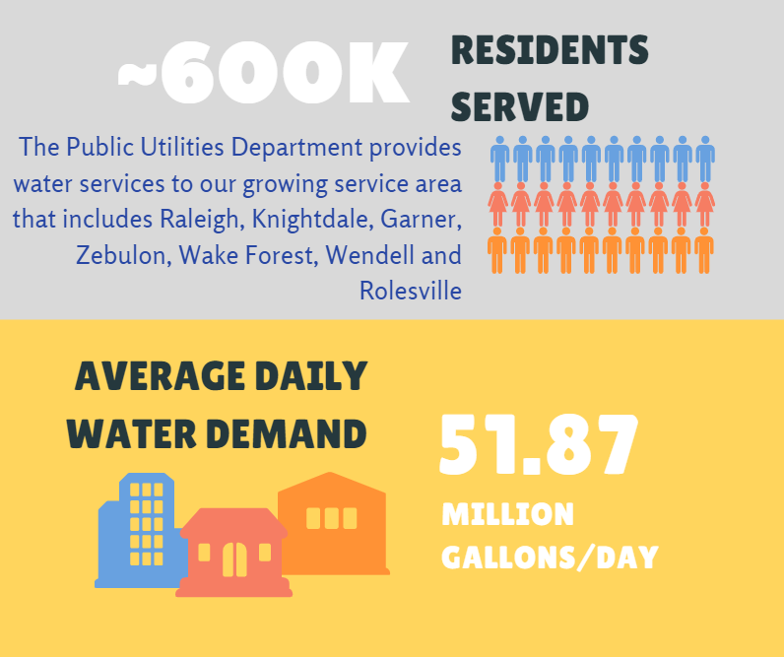
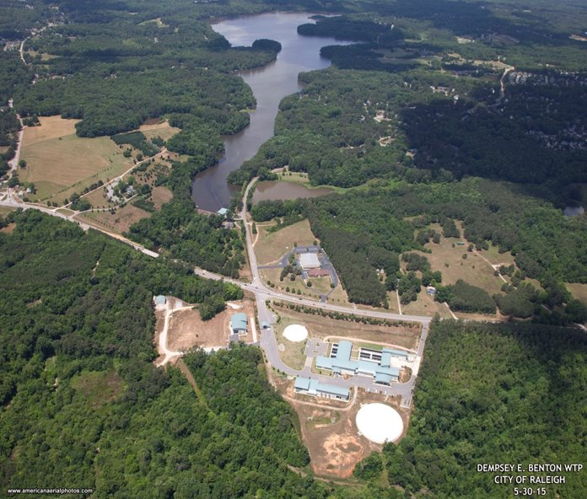
The Utility by the Numbers
2

Slide 3
Drinking Water Resources
EM Johnson Treatment Plant withdraws water from Falls Lake
(86 MGD -> 120 MGD)
Dempsey Benton Treatment Plant withdraws water from Lake Benson
(20 MGD)
3

Slide 4
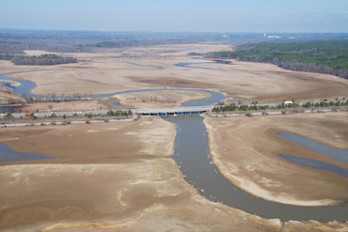
Motivation Towards Efficiency
Max day pumpage in September 2007 of ~77 MGD (86 MGD treatment capacity)
Water supply pool at Falls Lake at ~20% remaining on December 25, 2007)
Average irrigation demand in summer of 2007 was ~20 MGD over demand in cooler months
4

Slide 5
Improving Water Efficiency
People
(customers)
Processes
(the utility)
5

Slide 6
Changing water use behavior
Tiered residential water rates (apply highest tier to irrigation accounts)
Separate irrigation meter
Incentivize water efficient fixtures
Switch to monthly billing
Adopt rates that reflect the true cost of service
6

Slide 7
“Stabilized” Water Demand
7

Slide 8
Non-Revenue Water (formerly known as “unaccounted for water”)
Leaks
Fire pump exercising
Theft/tampering
Billing & data errors
Meter inefficiencies
Process/flush water
Water lost during a line break

Slide 9
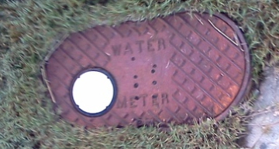
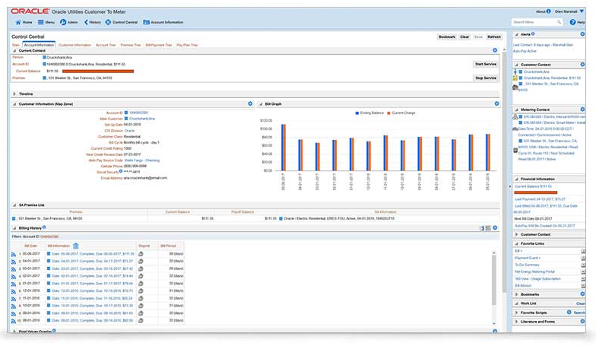
Billing and Meters
Replaced all residential and small non-residential meters with AMR meters by 2010
Have since installed ~75,000 smart meters
Currently replacing large meters
Billing system audit and software upgrades
9

Slide 10
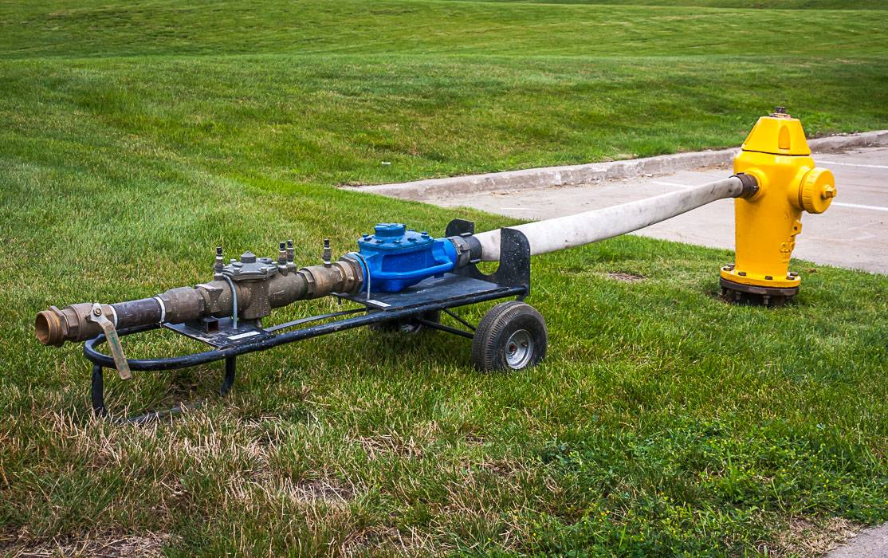
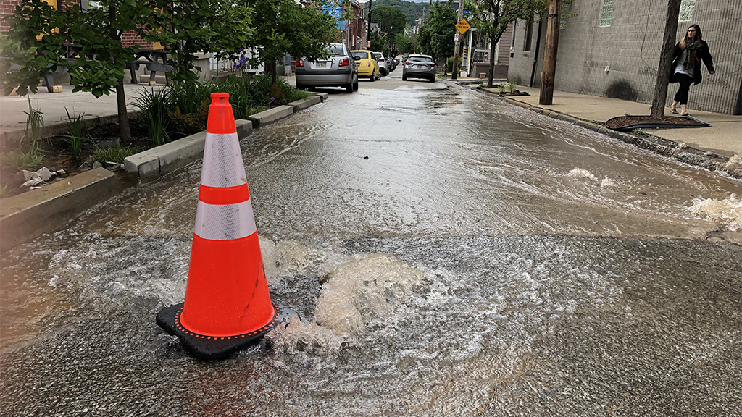
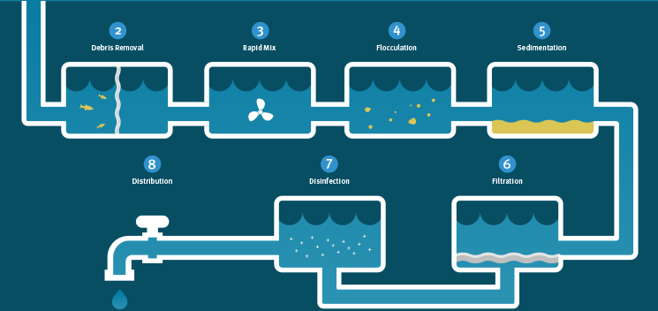
Accounting for Unavoidable Water Use
Recording water used for flushing
Estimating water lost during breaks
Metering plant process water
10

Slide 11
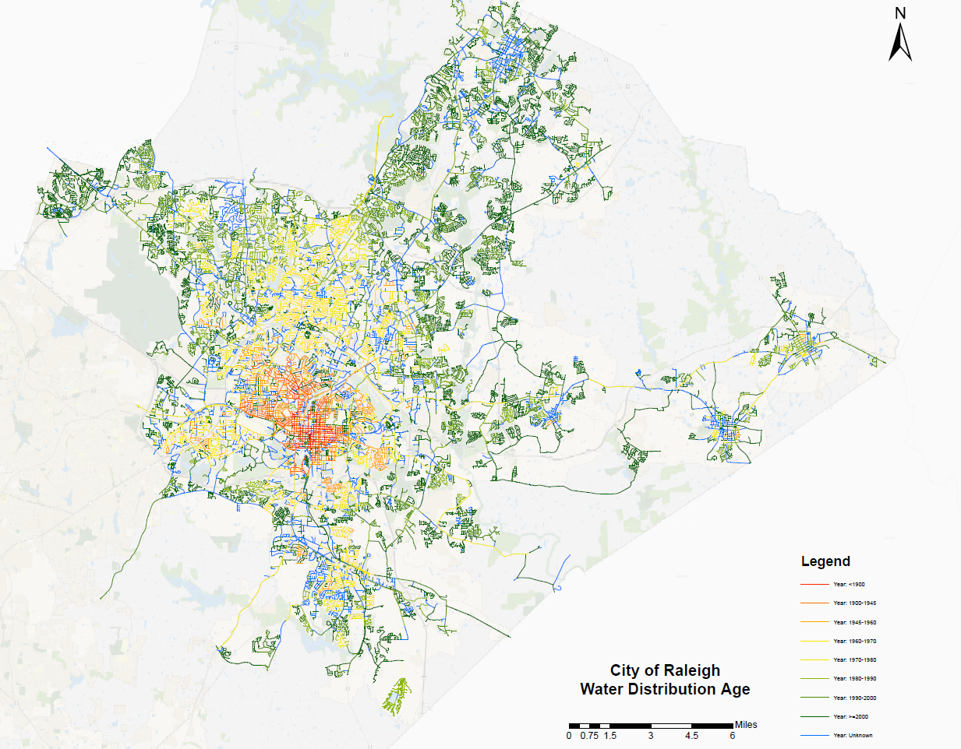
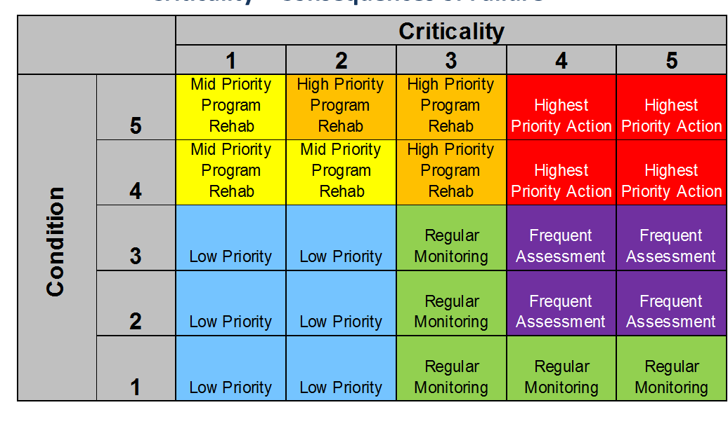
Leaks and CIP Investments
Use of data loggers to help locate leaks
Many leaks in service lines
Conduct condition assessment of distribution system
Use of water main break data to direct line replacements
11

Slide 12
Billed Water vs. Metered Water
Percentage Difference
12

Slide 13
Main Benefits
More efficient use of a limited resource
Reduced revenue loss
Deferment of substantial new resource capital projects
More stable demands and revenue projections
13

Slide 14
Questions ???
14

